Slide 1

UCB Project 1
Darley Chen
Nelson Lin
Anusha Balasubramanian
Cynthia Street
Tico Brown

Slide 2

Insurance Customer Analysis
Marketing Analysis
Key Features:
- Opportunities to optimize targeted marketing strategies
- Valuable insights for improving campaign effectiveness
- Analysis on purchase behavior to identify high-value customer segments
- Understand customer preferences and tailoring product offerings accordingly
- Evaluate the validity of marketing strategies and iterating for continuous improvement
- Explore the dataset to unlock actionable insights and drive success in the marketing initiatives
This Photo by Unknown author is licensed under CC BY-NC.

Slide 3
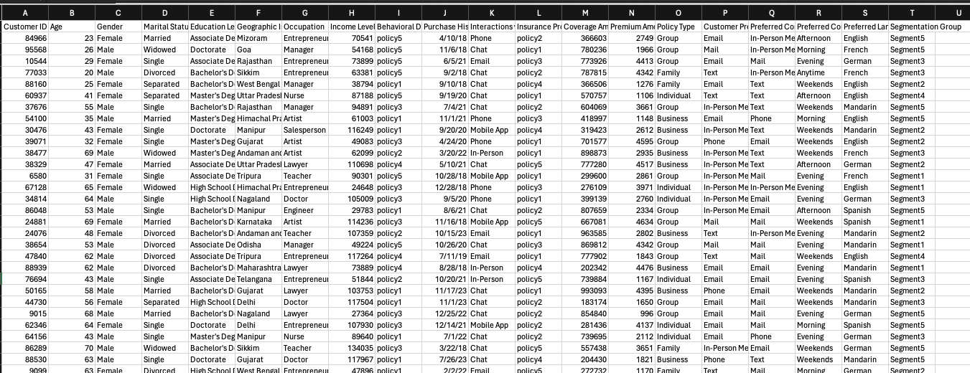
Introduction to Data
The dataset covers a diverse range of demographics and preferences
Data is collected from customers located throughout India
Variables such as income level and education level provide insights into the customer's socioeconomic status
Purchase history and interactions can be used for customer behavior analysis
Understanding customer preferences and communication channels can inform marketing strategies and customer service approaches

Slide 4





Data Processing Pipeline
Extract Data
Transform / Clean Data
Load Data
Analyze Data
Visualize Data
Insurance dataset for customer segmentation analysis
Data includes fields like customer ID, Age, Policy type, coverage amount, premium amount etc.,
Source: Kaggle.com
Assumed every record is unique even with duplicate customer ID's, because same customer can have multiple policies
Added a column "customer number" to make the records unique
Created a DataFrame "cs_df" to load the data
Insurance Coverage Amount vs. Income Level
Occupation vs. Communication Channel
Premium Amount vs. Age
Marital Status vs. Policy type
Age Group vs Customer Coverage Amount
Visualized the findings using various charts including bar chart, line plot and Pie Chart.
Conducted statistical analysis such as ANOVA and Chi-Square test.
Summarized the Findings.

Slide 5
Findings

Slide 6
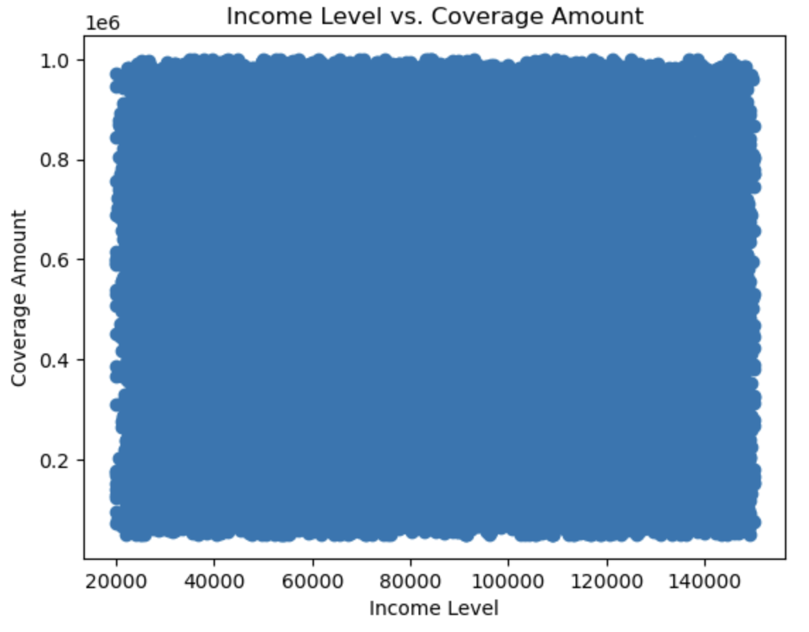
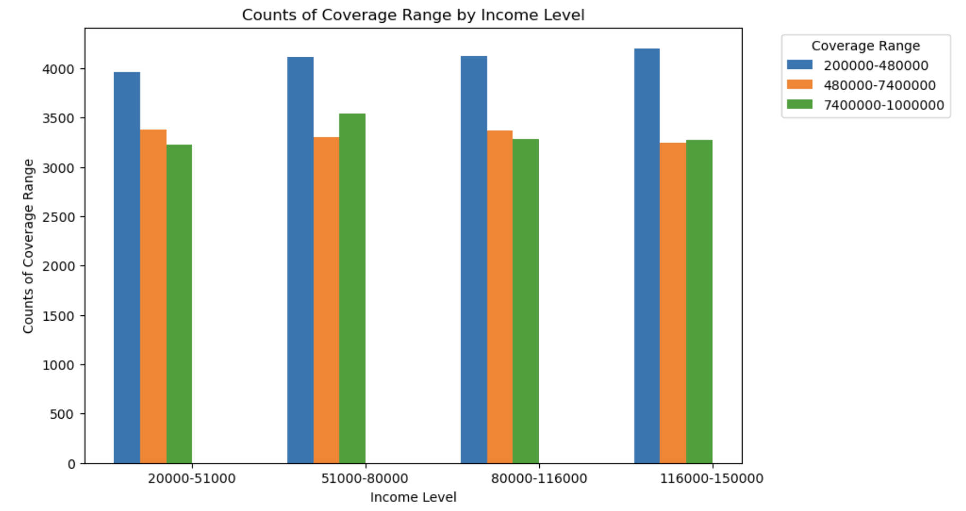
Insurace Coverage vs. Income Level
The correlation between Insurance Coverage and Income Level is: -0.018.
There is a very weak negative correlation between Insurance Coverage and Income Level in the dataset.

Slide 7
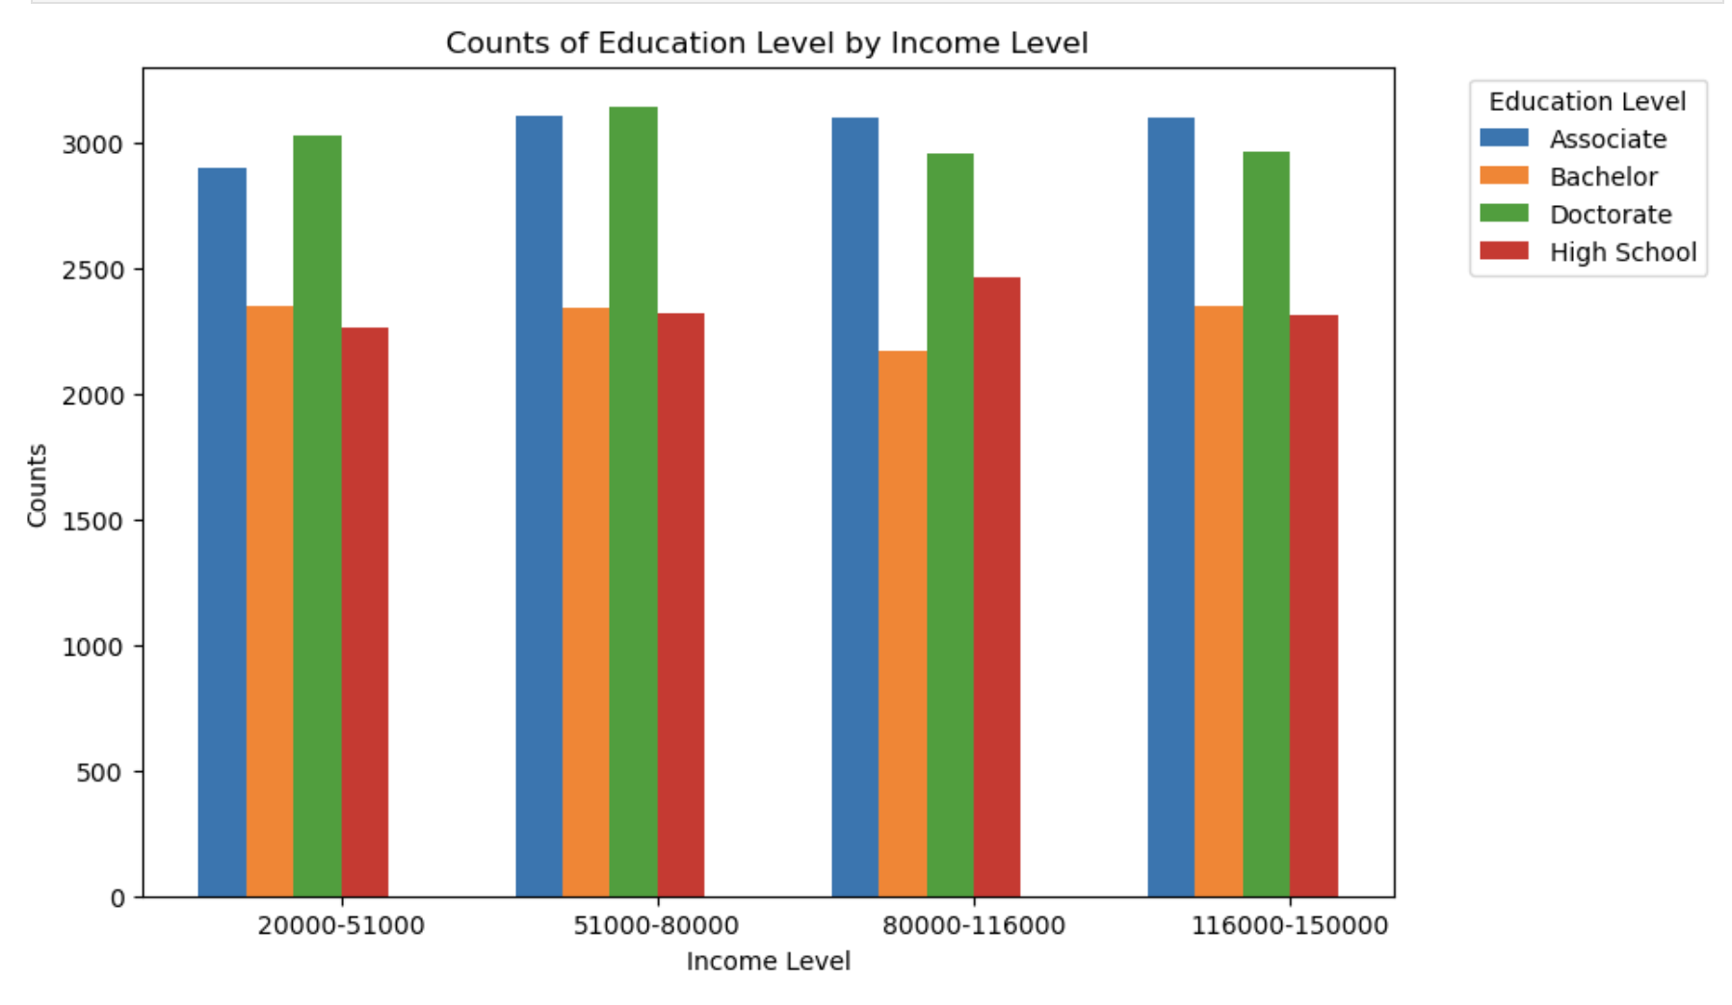
Education Level vs. Income Level

Slide 8
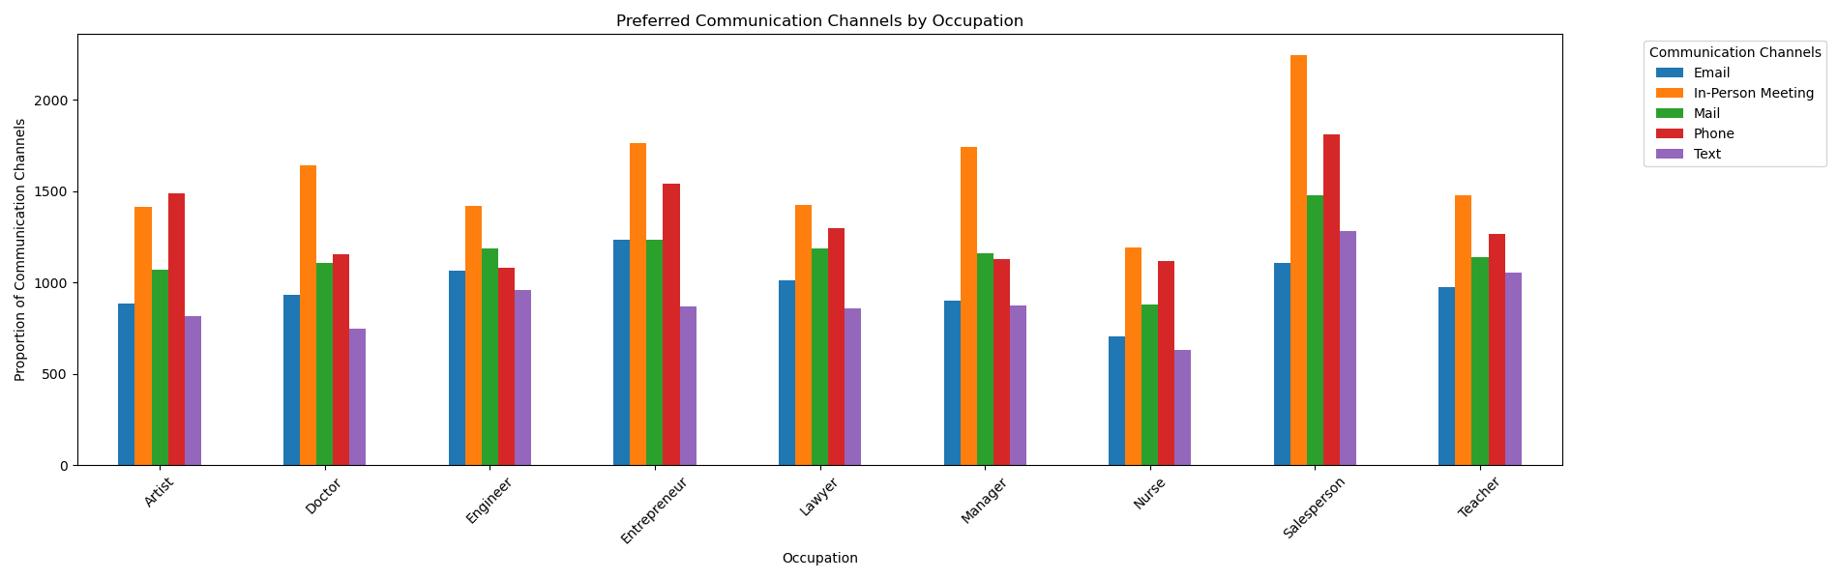
Occupation vs Communication Channel
Chi-square test results for communication channels: Chi-square statistic: 366.17317802763915 P-value: 2.222025091627914e-58
Preferred Method: In-Person Meeting
Least Preferred Method: Text

Slide 9
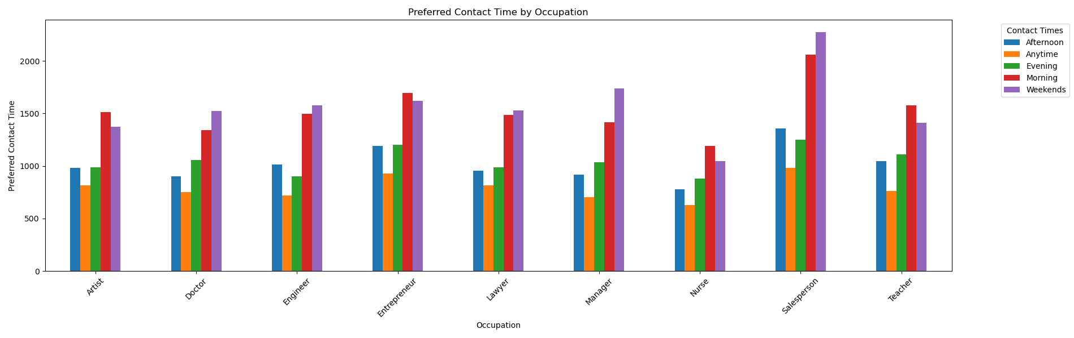
Occupation vs Contact Time
Preferred Contact Time: Weekends / Morning
Least Preferred Contact Time: Afternoon / Evening

Slide 10
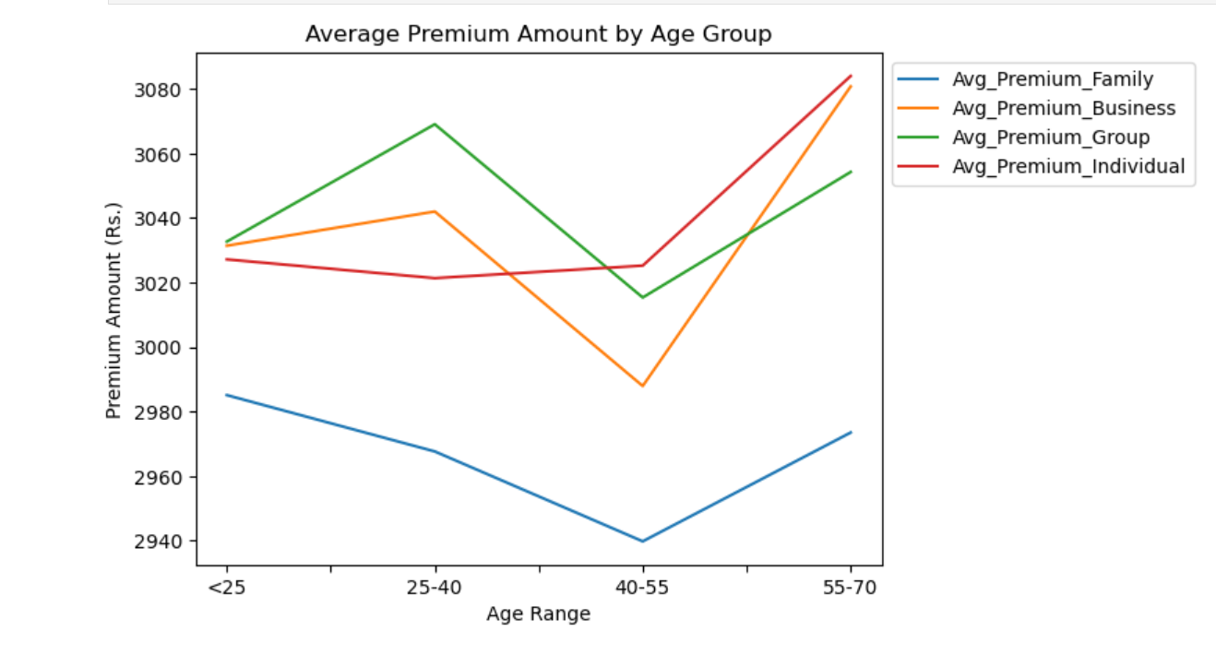
Premium Coverage Amount vs Age
Family policies tend to have lower premium compared to other policy types.
Age group between 40 – 55 has lower premium coverage amount on average.
People in age group 55-70 have higher premium amounts across policy types due to age associated risks.

Slide 11
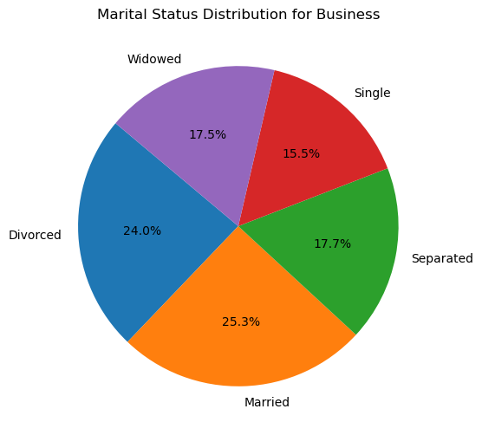
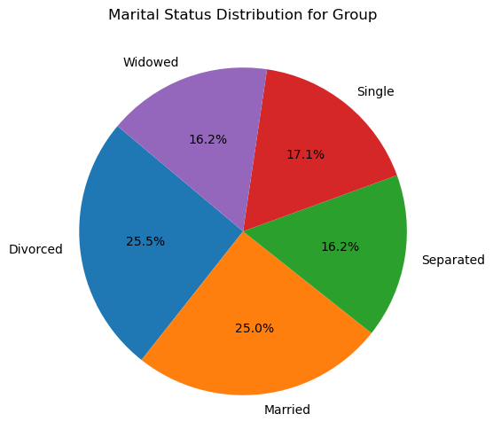
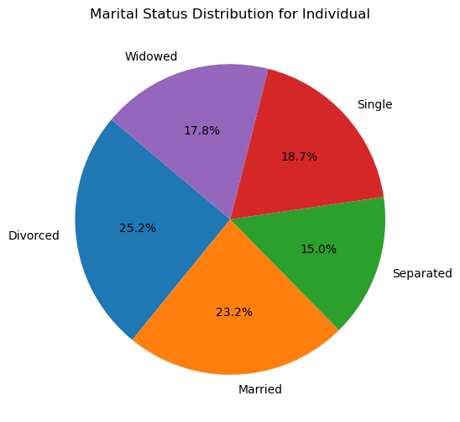
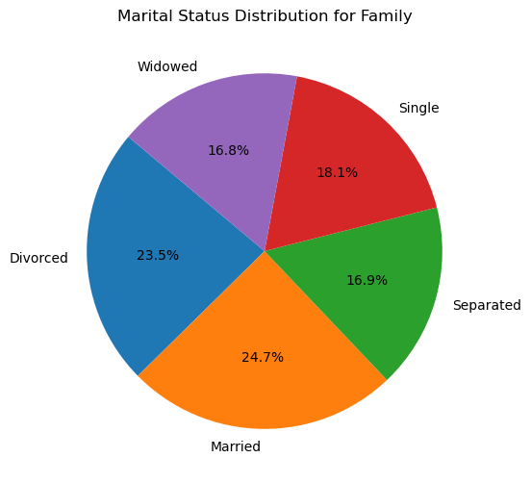
Marital Status vs Policy Type
For Group Policy and Individual Policy, the majority of policy holders are divorced. For Family Policy and Business Policy, the majority of policy holders are married.

Slide 12
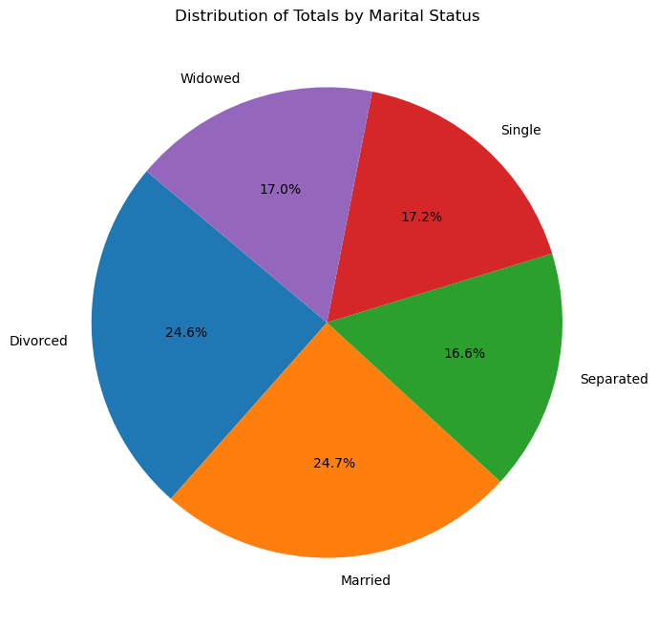

Slide 13
For Group Policy and Individual Policy, the majority of policy holders are divorced. For Family Policy and Business Policy, the majority of policy holders are married.
Questions for the class
Why are the majority of group and individual policy holders divorced?
Why are the majority of family and business policy holders married?
*group policy assumed to be insurance policy provided by employer

Slide 14
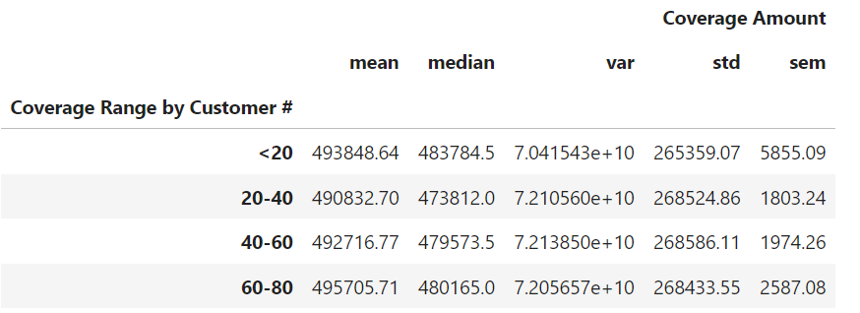
Age Group vs Coverage Amount
Establish the bins: age bracket = [0, 20, 40, 60, 80]
Null Hypothesis: There is no difference in the average coverage amount between different age groups
Alternative Hypothesis: There is a difference in the average coverage amount between age groups
F-Statistic: 0.82
p-value: 0.48
Conclusion: Fail to reject the null hypothesis. There is no statistically significant difference in the average coverage amount across different age groups.

Slide 15
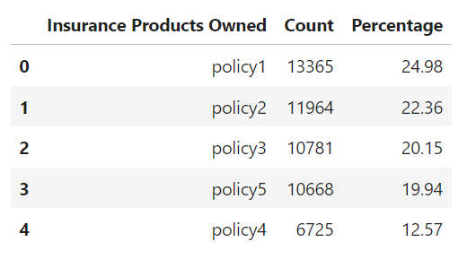
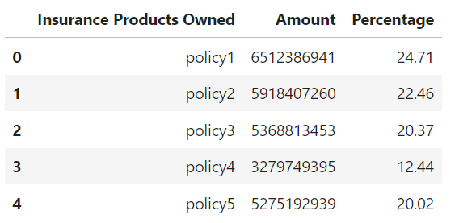
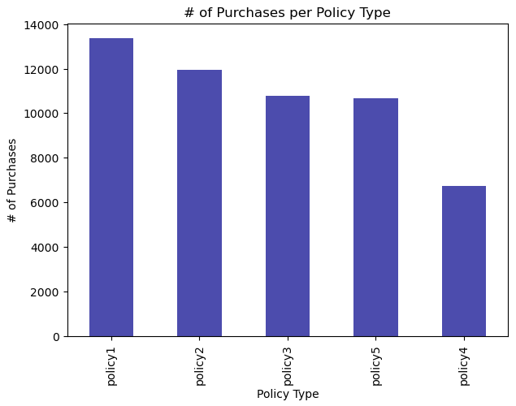
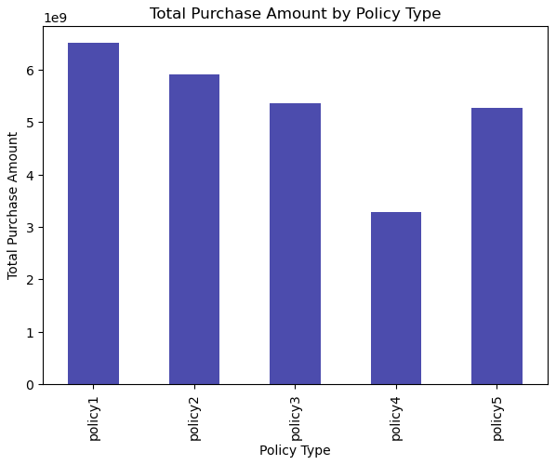
Challenges and Future Opportunities
Perform the analysis on only policy 1 & 2
Unable to utilize the "Segment" column
API key could be utilized with the "Geographic Information" column
Benchmark against industrial standards check with validity of the dataset

Slide 16
References
Customer segmentation data. (2024, March 11). Kaggle. https://www.kaggle.com/datasets/ravalsmit/customer-segmentation-data
Deventer, C. (2024, March 14). Auto insurance rates by age in 2024. Bankrate. https://www.bankrate.com/insurance/car/auto-insurance-rates-by-age/
Git: “please tell me who you are” error. (n.d.). Stack Overflow. https://stackoverflow.com/questions/11656761/git-please-tell-me-who-you-are-error

Slide 17

Q/A

